Slide 1


PETRA IV progress
Riccardo Bartolini
PETRA IV Machine Project Leader
LEL 2022, 3rd workshop on low emittance lattice design, June 27th 2022

Slide 2
  Outline
The PETRA IV project
Lattice design and analysis
Damping wigglers and IBS for PETRA IV
(short) highlight of technical system
Conclusions

Slide 3
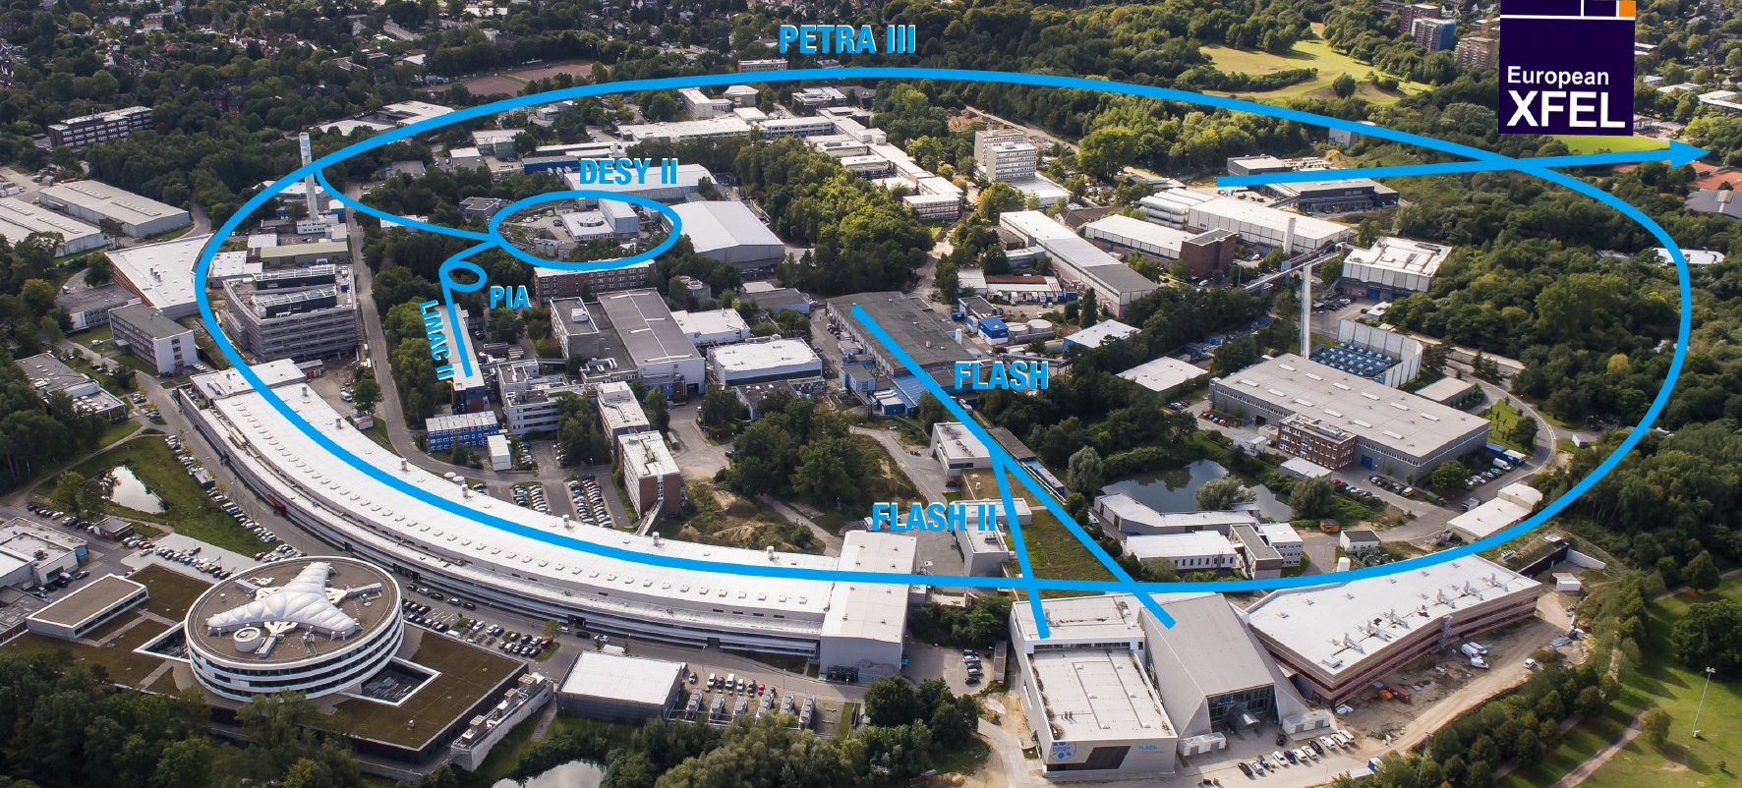
  PETRA III is one of the core facilities at DESY
Each year ~5000h users operation serve more than 2000 users
Ada Yonath Hall
Extension Hall East
Parameter | PETRA III
Energy [GeV] | 6
Circumference [m] | 2304
Emittance (hor./vert.) [nm] | 1.3 / 0.013
Total current [mA] | 100
Max von Laue Hall
Paul P. Ewald Hall
Extension Hall North
PETRA IV project:
replacing PIII with an ultra low emittance ring (20 pm) adding a new Experimental Halls in two more octants

Slide 4
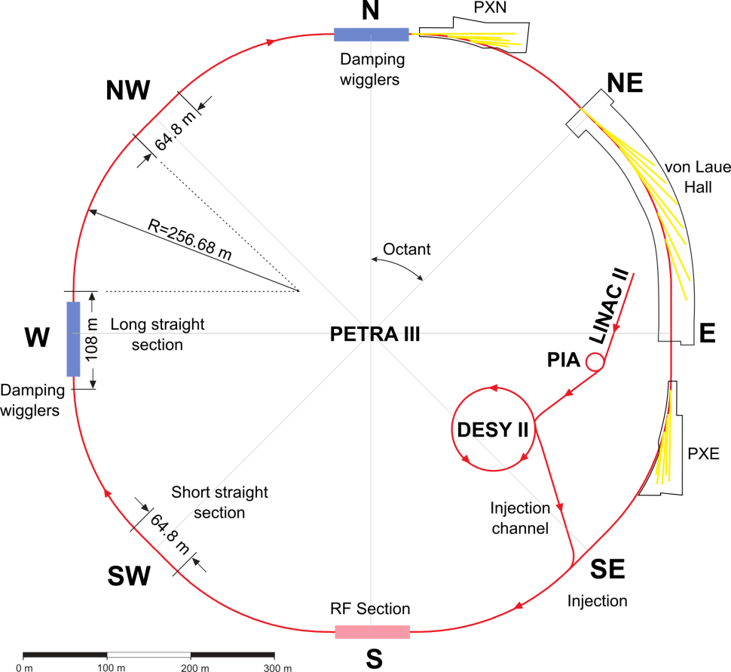
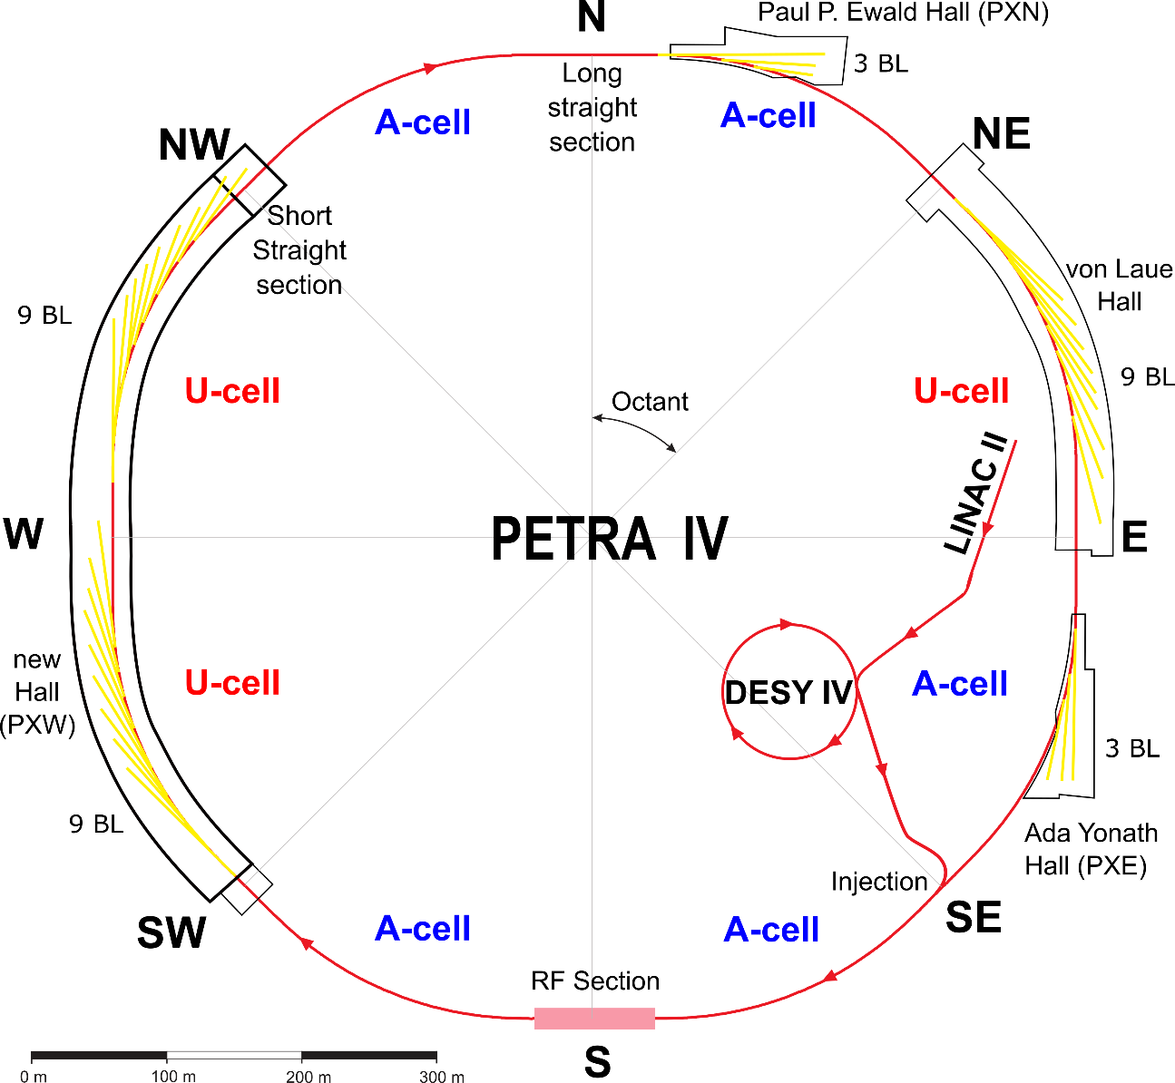
  from PETRA III to PETRA IV
1300 pm → 20 pm
PIA
Eight Arcs (45°), 201.6 m long
  One arc build from 9 DBA cells L_{cell} = 23 m, 5 m ID straight sections
  5 pure FODO-arcs + 2 modified FODO arcs with 2 DBA cells
Beamlines
  Max von-Laue Hall:14; PXN:5; PXE: 7
Eight Arcs (45°), 201.6 m long
  72 cells ESRF-EBS H6BA cells
  9 cells per arc L_{cell} = 22.75 m, 4.3(TBC) m ID straight sections
Straights for Beamlines
  Max von-Laue Hall: 9; PXN: 3; PXE: 3 + New Hall: 9 + 9(8)

Slide 5
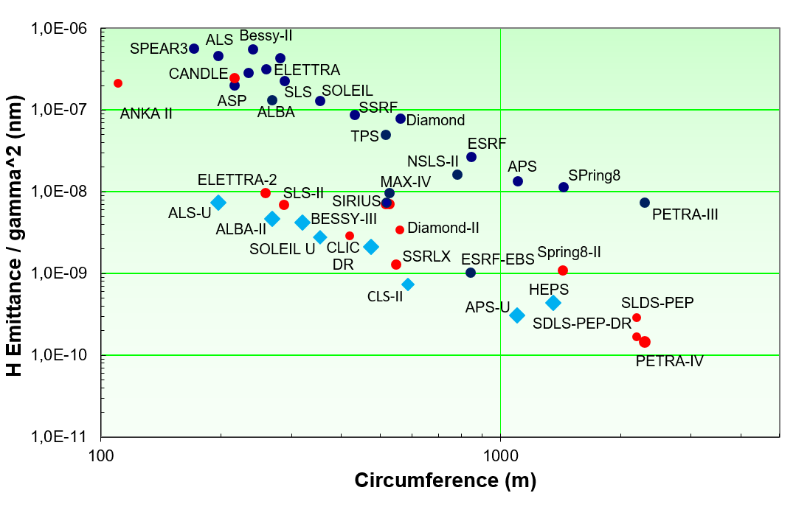
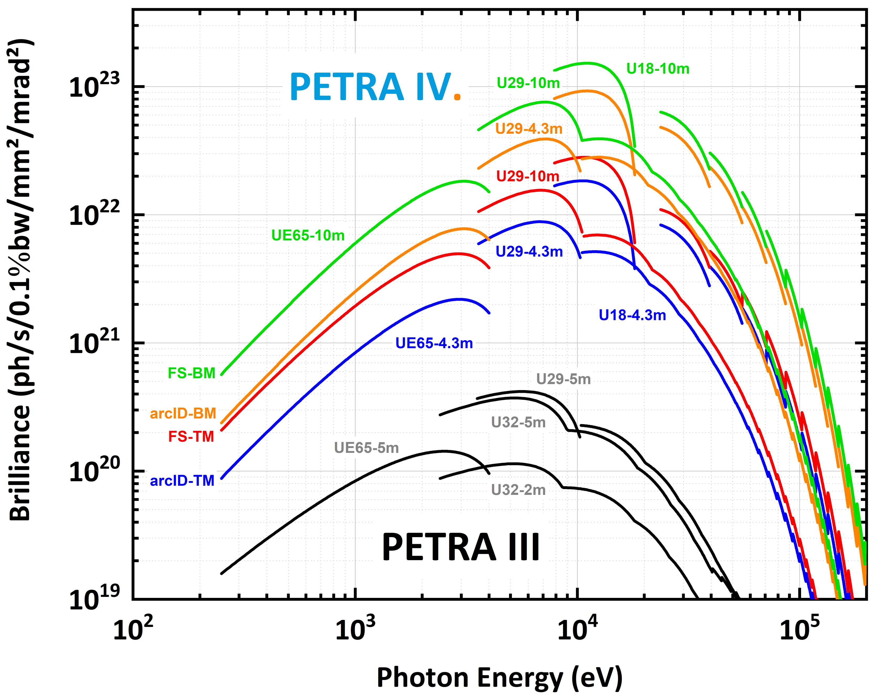
  Landscape of low emittance rings
DBA/TBA
MBA
+ technology
emittance: : ~ 20 x 4 pmrad²
undulators: 4.3 m and 10 m
optimised beta 2.2 m
ring current: 200 mA
Brightness increase of * 500-1000
On-axis inj.
+ technology
Multibend achromat technology underpins the development of diffraction limited light sources
HEPS <60 pm; APS-U 42 pm; PETRA IV 20 pm;
Ultra-low emittance rings provide high brightness and coherence up to high photon energies
Notes:
Apologies – updated to the best of my knowledge
Highlight PETRAIV-DLSD-SSLRX-CLICDR- ESRF-EBS

Slide 6
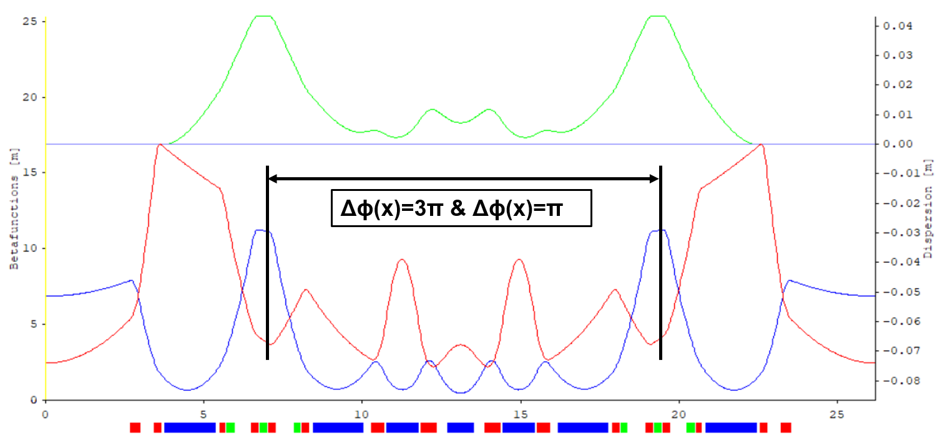
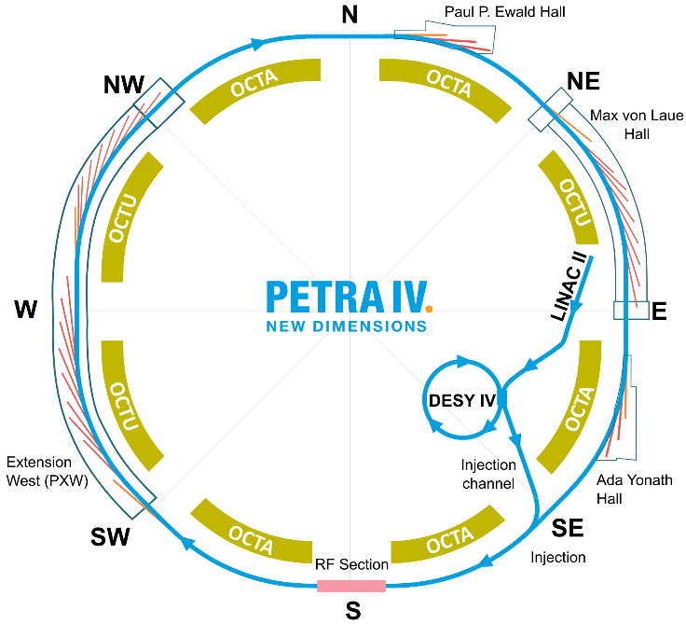
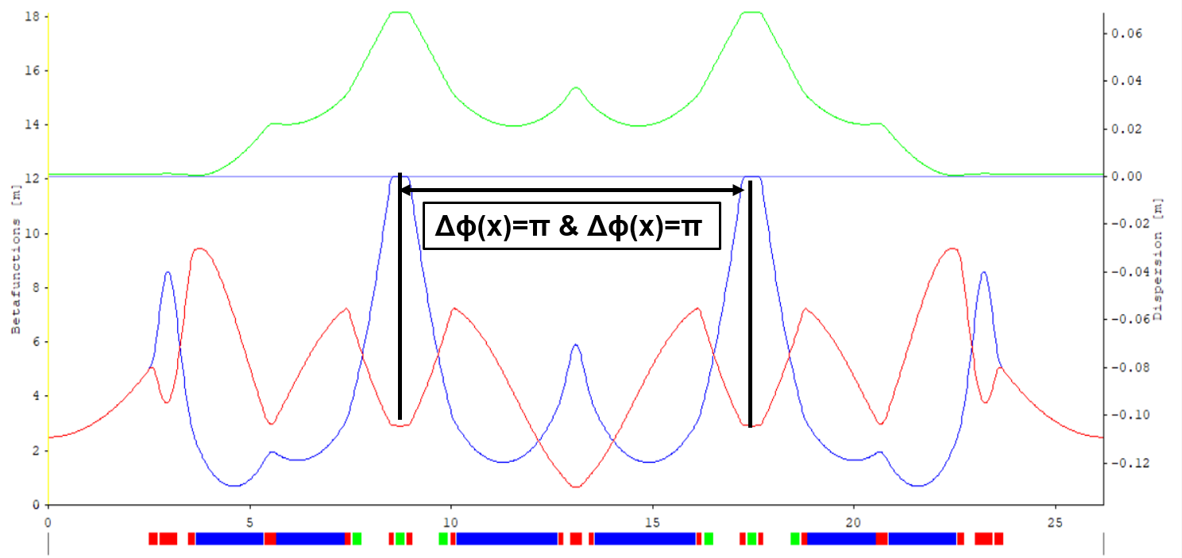
  PETRA IV lattice based on a H6BA cell proposed by
  P. Raimondi
First version of H6BA in collaboration with ERSF
Classic H7BA
H6BA cell (43 pm):
2 DLQs and 4 DQs
Same cell structure replicated across all octants
Achieving 20 pm beam emittance with DW and relaxed arcs
Extensive use of damping wigglers in 5 octants (OCTA) for emittance damping and control.
Undulator beamlines in 3 octants (OCTU)
H6BA

Slide 7

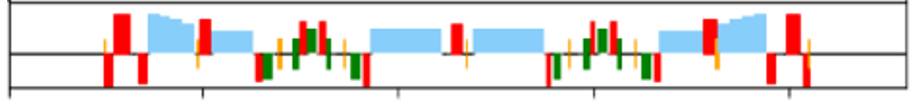
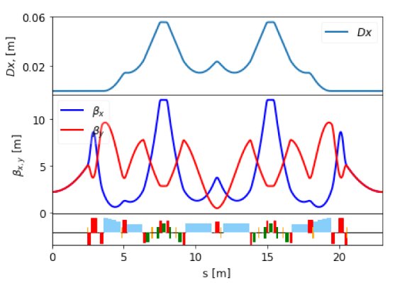
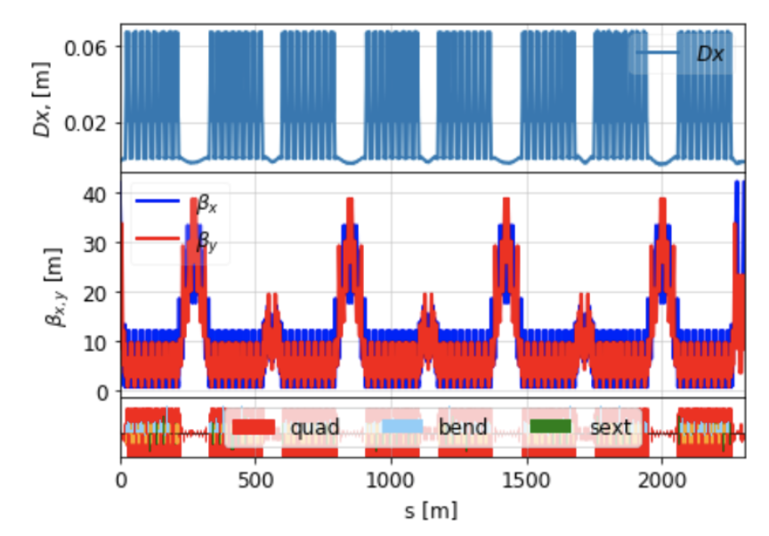
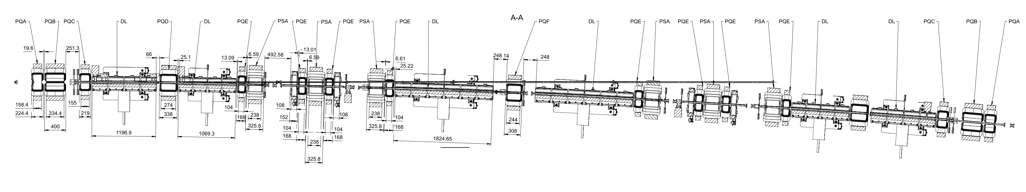
H6BA cell design stable: the baseline lattice is frozen
Items investigated: sensitivity to errors, number and type of correctors. We have refined the lattice and recently agreed to freeze the main hardware components: dipoles, quadrupoles, sextupoles, RF section.
DQ3
DQ3
DLQ1
DQ2
DQ2
DLQ1

Slide 8
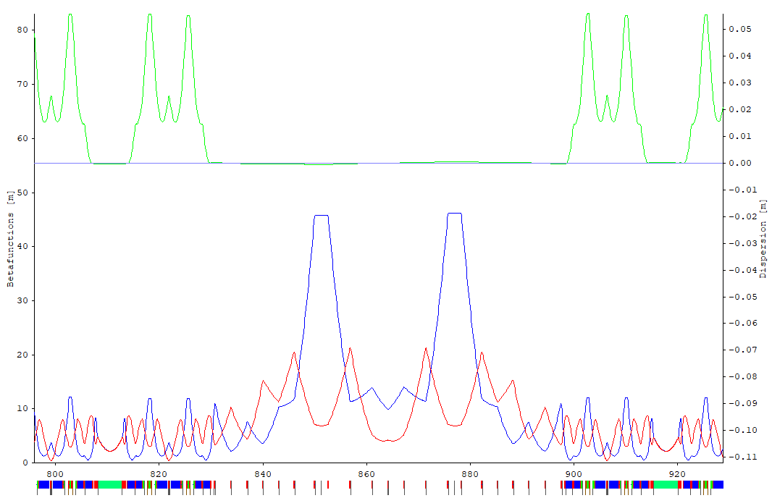
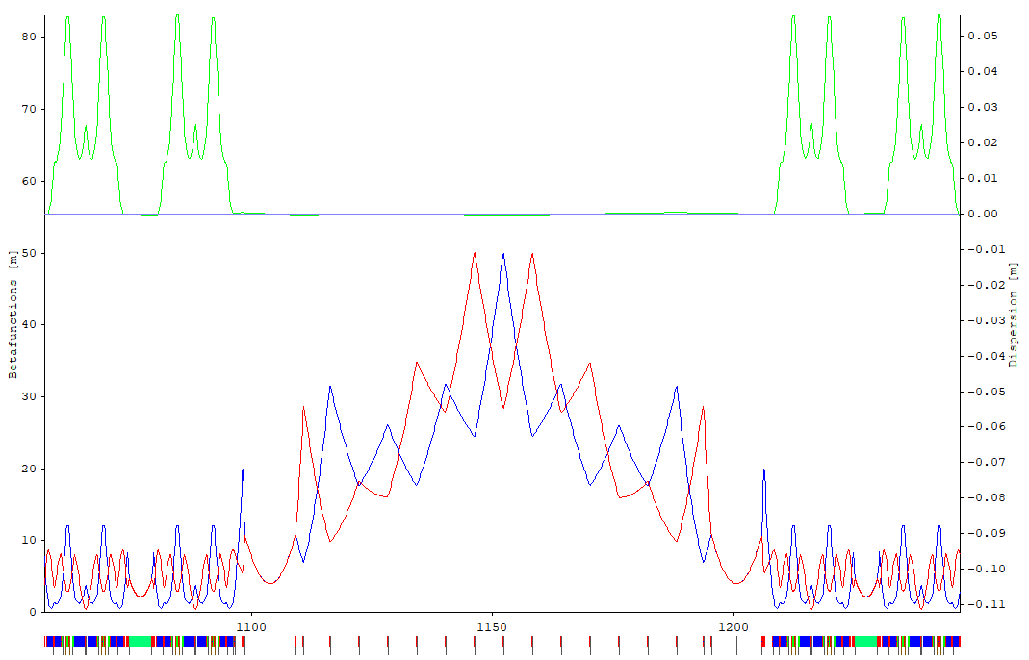
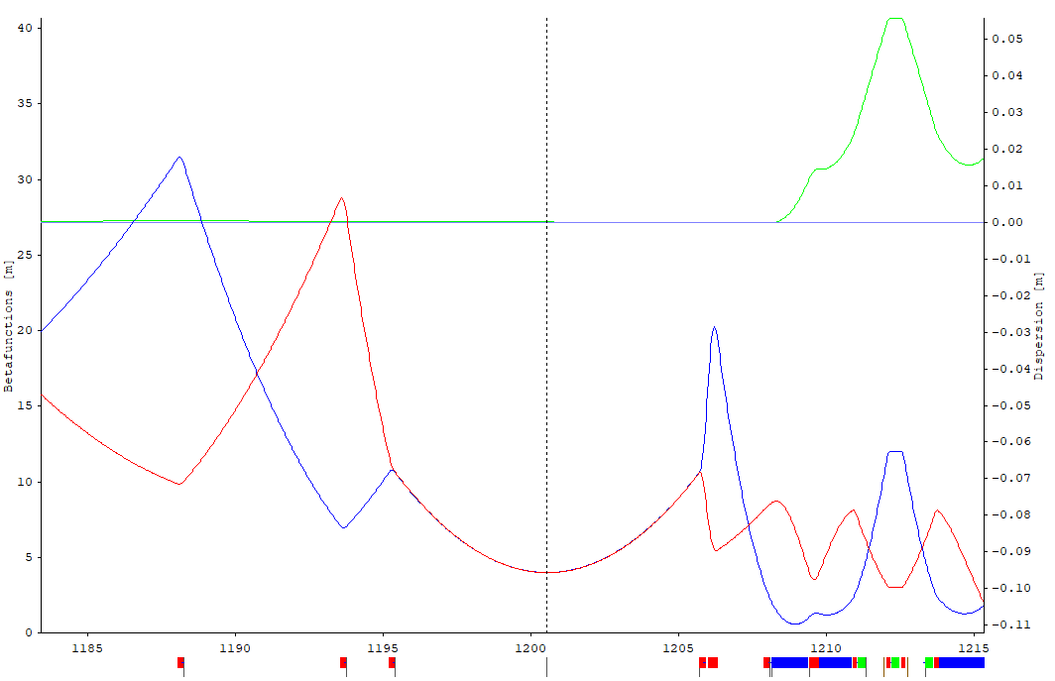
  Long and Short Straight Sections in PETRA IV tunnel
Straight section with equal phase advance of 2π plus space for super ID beamlines
Injection
Long Straight Section (LSS)
2π
2π
Injection
β_{x} = 46 m
1 (short) Injection section with two large β_{x} peaks (~46 m) and α_{x} = 0 for off-axis injection
3 Short Straight Sections (SSS) with β*_{x,y} = 4 m for 10 m long undulator
4 Long Straight Sections (LSS) with β*_{x,y} = 4 m for 10 m long undulator
All straight sections have a phase advance of φ_{x,y} = 2π
→ increases periodicity of the lattice
Space for
10 m long
undulator
β*_{x,y} = 4 m

Slide 9
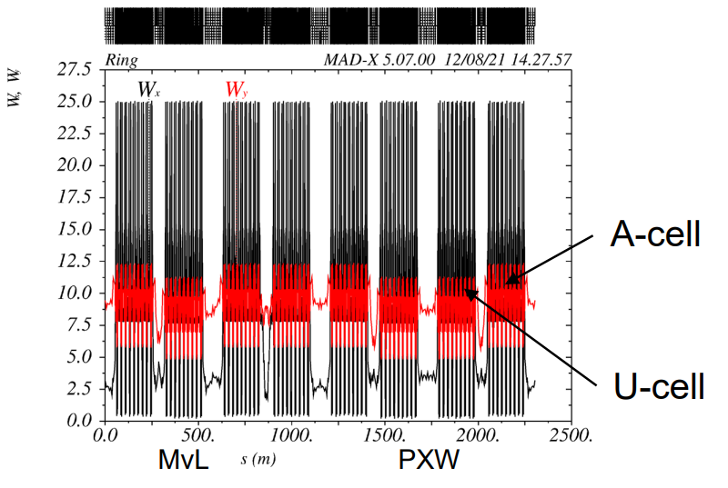
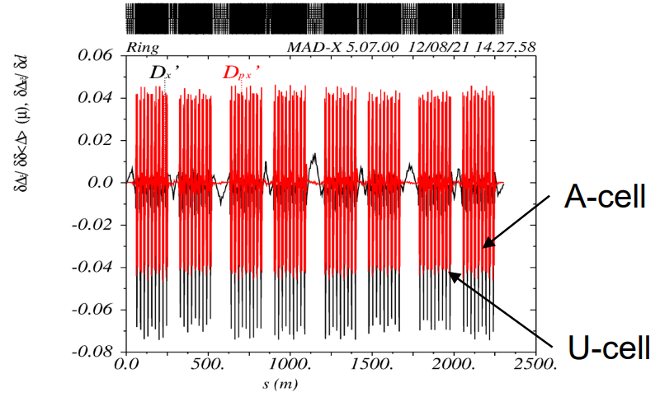
  Matching of chromatic functions is essential
The arcs and straight sections are matched also wrt the chromatic functions Wx, Wy DDx DDPx
No beating of Wx, Wy, D’x , D’px for the full ring; otherwise the local momentum acceptance is reduced

Slide 10
  Main parameters of the H6BA lattice
Parameters | Brightness mode | Timing mode
Number of bunches | 1600-1920 | 80 (40)
Total current (mA) Single bunch current (mA) | 200 0.125 | 80 (80) 1 (2)
Arc ID (β_{x}/β_{y}) [m] Flagship ID (β_{x}/β_{y}) [m] | 2.2/2.2 4/4
Hor. Emittance ε_{x} [pm] Ver. Emittance ε_{y} [pm] | 20 5 | 35 (38) 7 (8)
Bunch length σ_{t} [ps] | 30 | 65 (75)
Energy spread σ_{ε} [%] | 0.9⋅10⁻³ | 1.2 (1.5)
Touschek lifetime [h] | ~10 | ~5

Slide 11
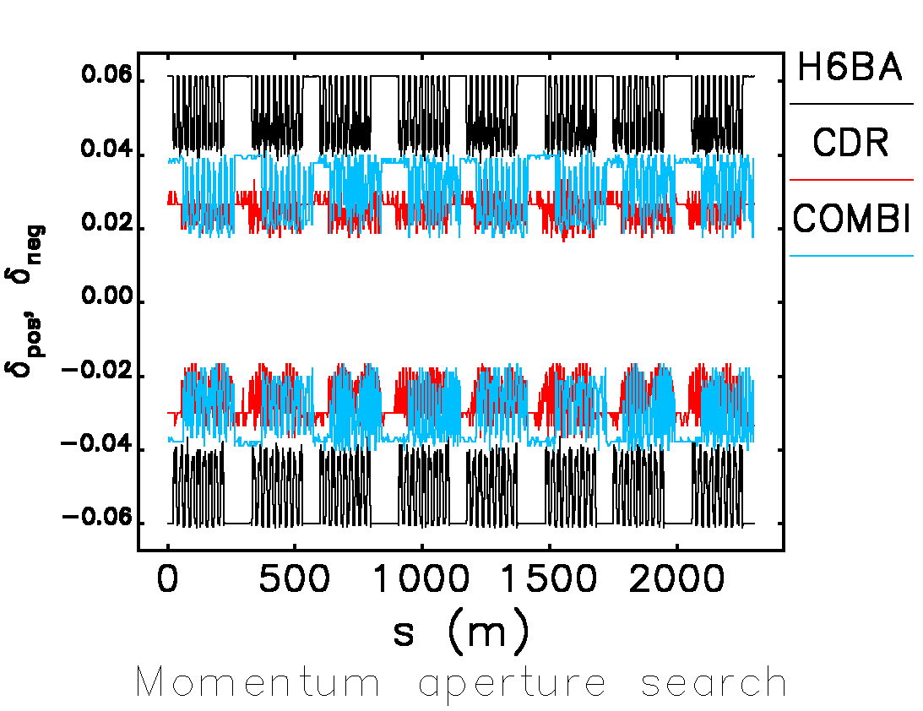
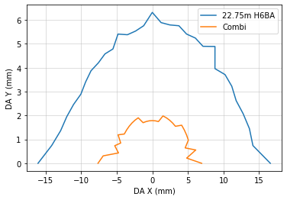
  Performance of the H6BA: bare lattice
The H6BA bare lattice has a remarkable performance (bare lattice)
Although this performance is significantly degraded by errors, it is still decisively better than the combi lattice and the CDR lattice previously used as baseline

Slide 12
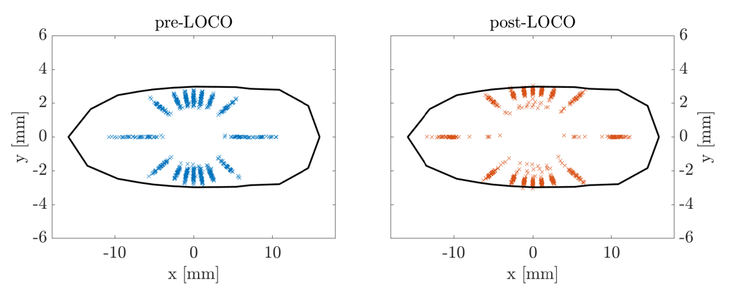
  Lattice with errors
The following error table are used to assess the robustness of the lattice optimization
Commissioning simulation are implemented
first turn threading
sextupole ramp up
RF on
orbit correction
tune correction
BBA [by hand so far]
LOCO
+/- 15 mm without errors reduces
to ~10 mm with few exceptions
Classic off-axis injection is possible

Slide 13
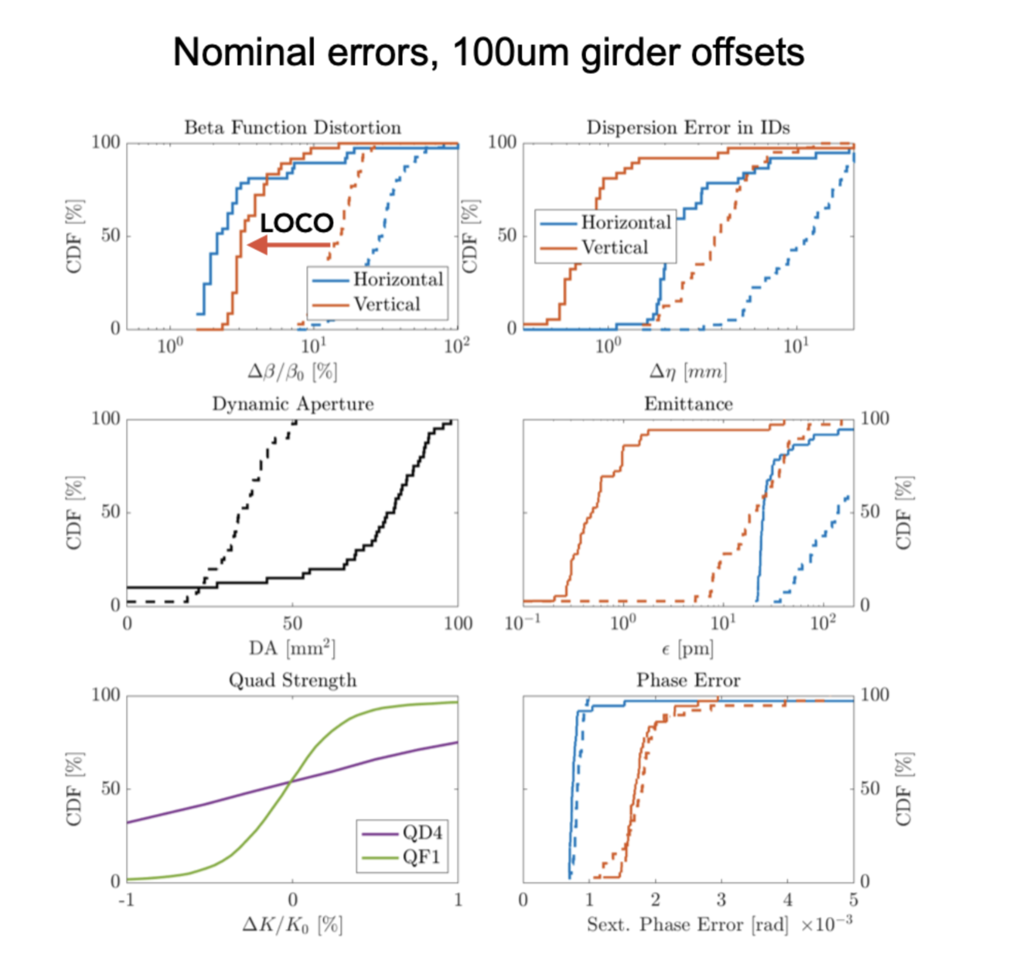
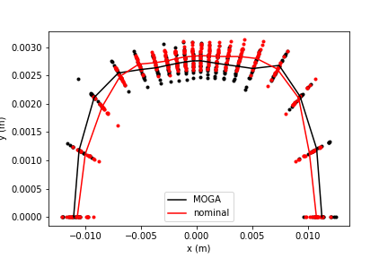
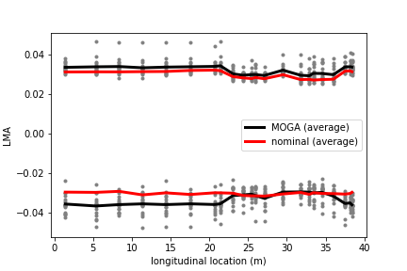
Commissioning simulations and tolerance analysis: machine operation is challenging but feasible
Nominal misalignments:
30 μm magnet-to-magnet
100 μm girder-to-girder
Beam parameters in the target range demonstrated:
  DA ~10 mm at injection point (with errors)
  LMA ~ 3% (with errors)
  lifetime ~10 h in brightness mode ~5 h in timing mode

Slide 14
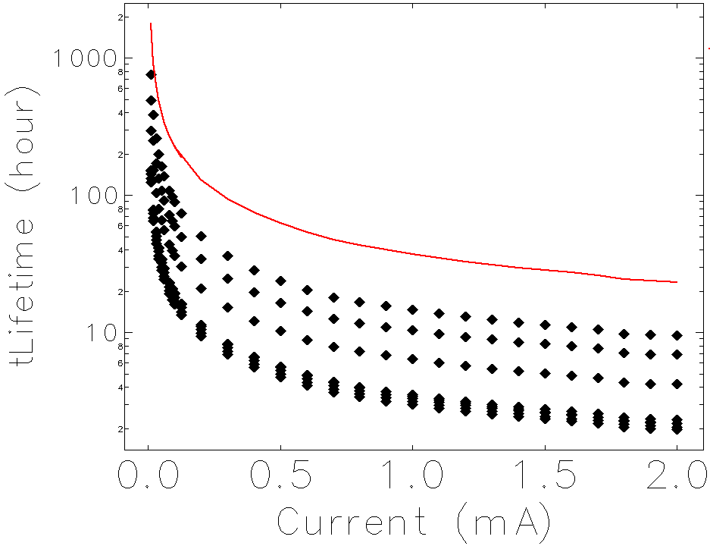
  Touschek lifetime of lattice with errors
Simulation of LMA and Touschek lifetime after orbit and optics correction (‘reasonably well corrected machine’)
Simulation procedure:
Misalignment of quadrupoles of various amplitudes
Correction of tunes & corrected the orbit with 100 SV per plane
Selected solution with 5% beta beating; computed LMA
Computed Touschek lifetime from LMA with IBS, 3rd harmonic cavities and impedance effects
Conditions:
22.75 m / 23 m H6BA lattice
1024 turns, SR on, 6D, RF voltage 8 MV, with aperture limitations
Touschek Lifetime for 5% beta beating:
Brightness mode (0.125 mA) mean >10 h
Timing mode (1 mA), mean > 5 h
Touschek Lifetime with 5% beta beating
Brightness
Timing
ideal

Slide 15
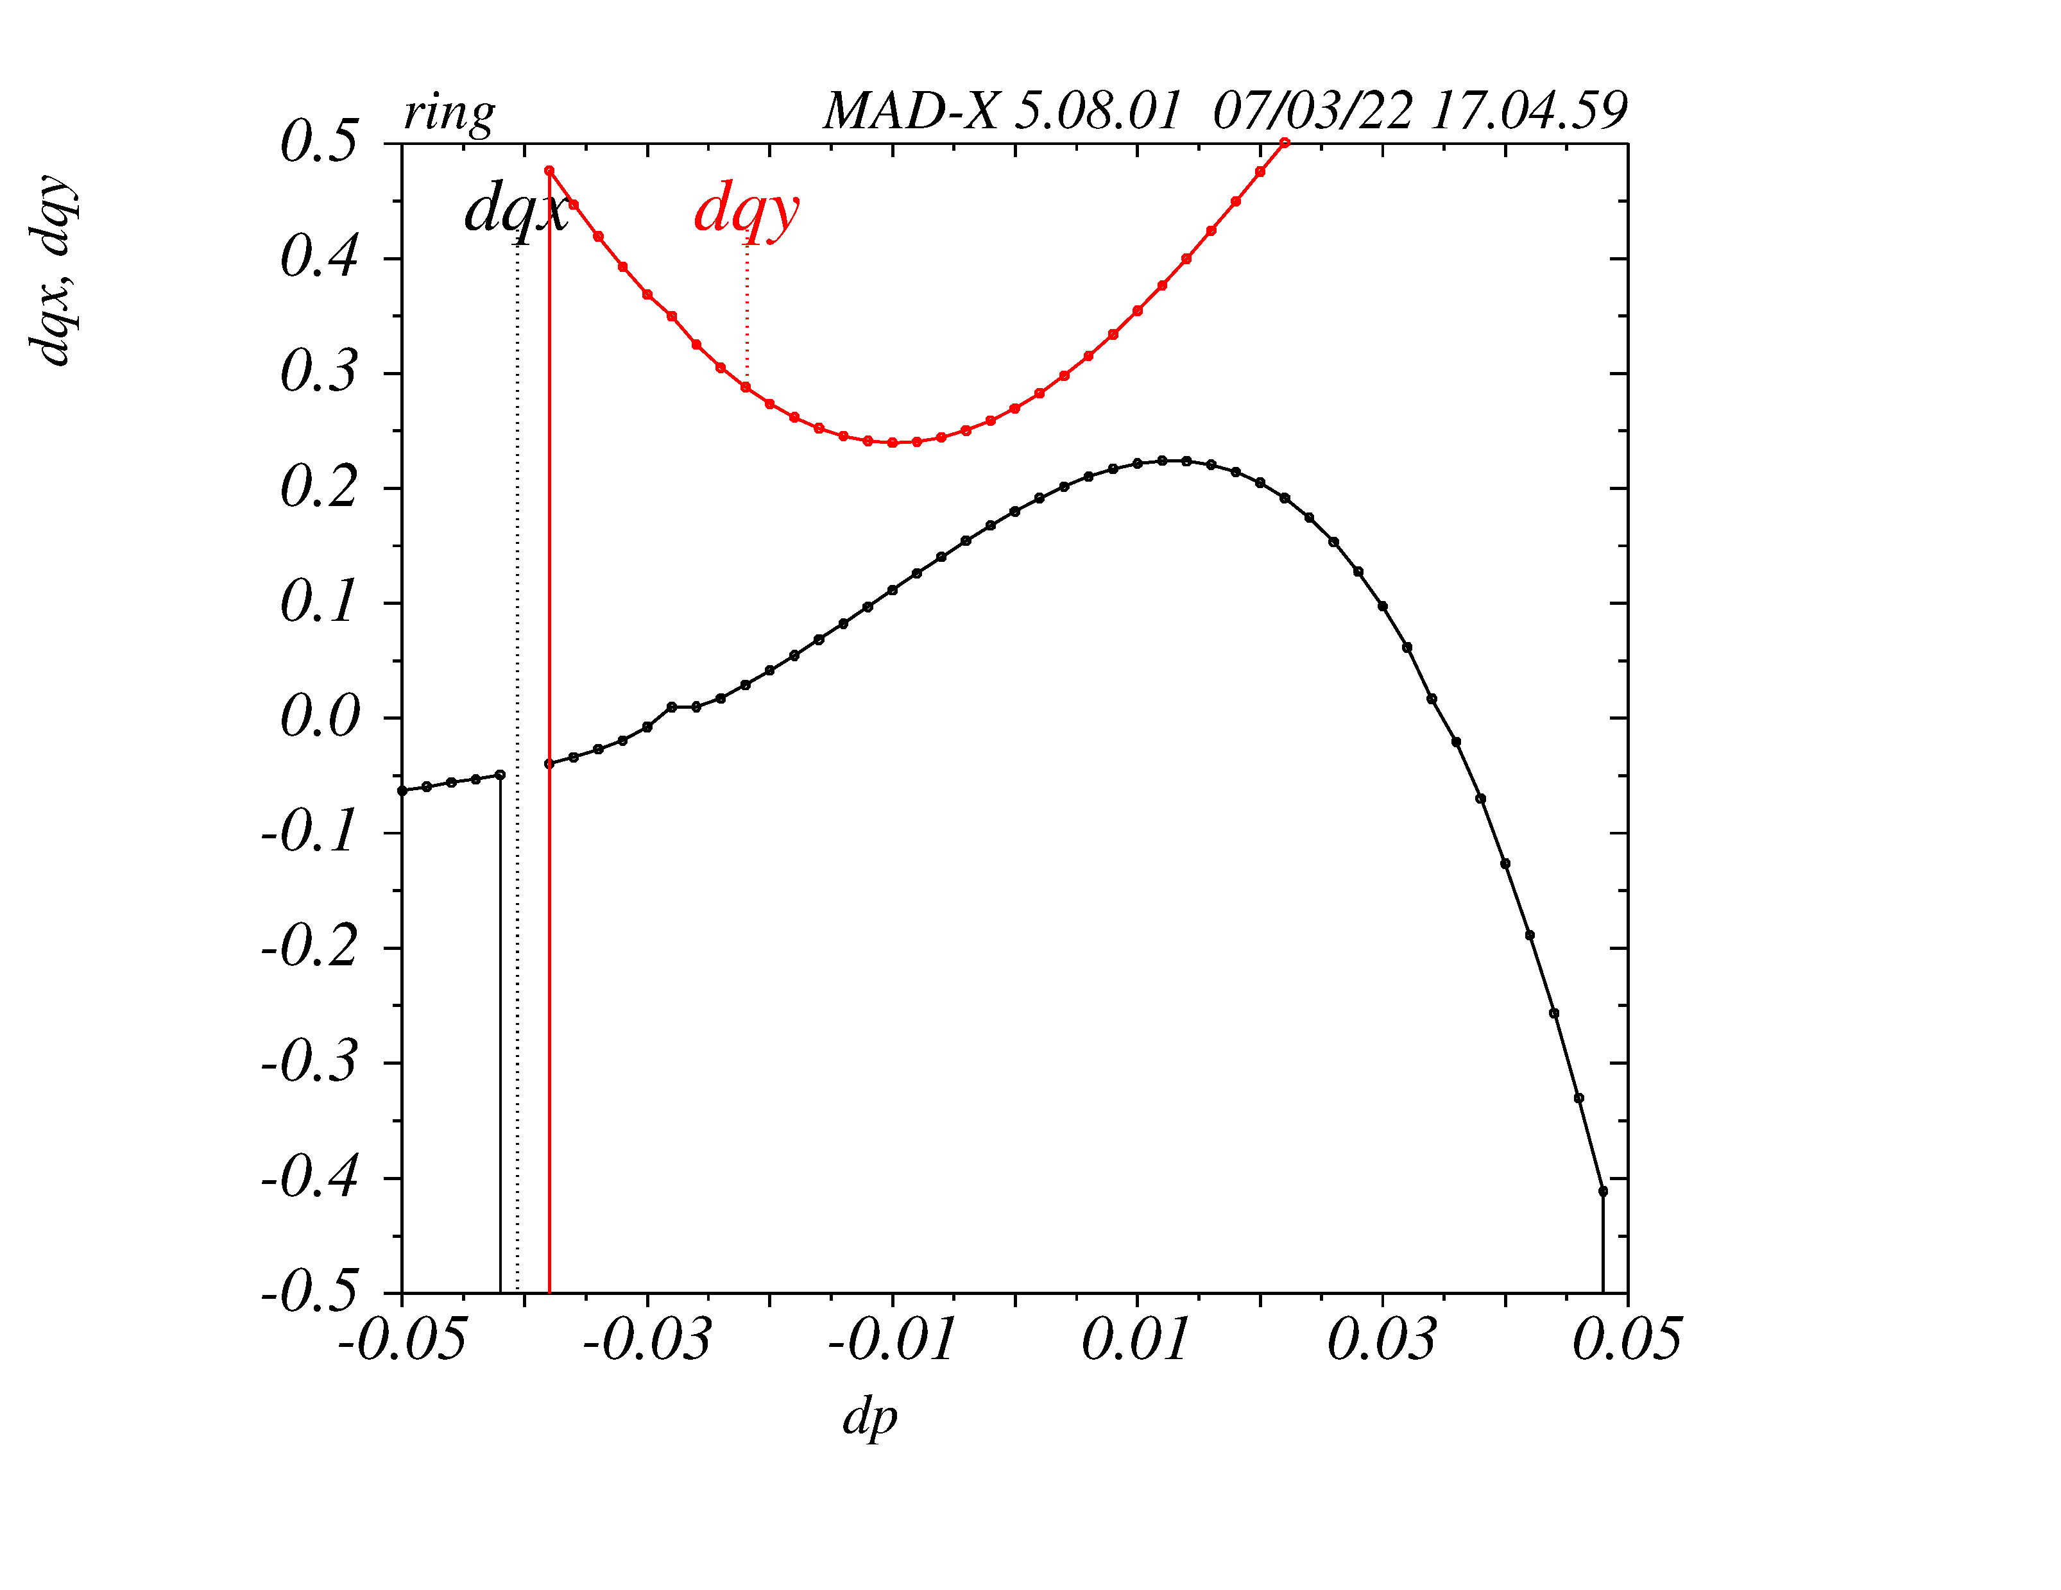
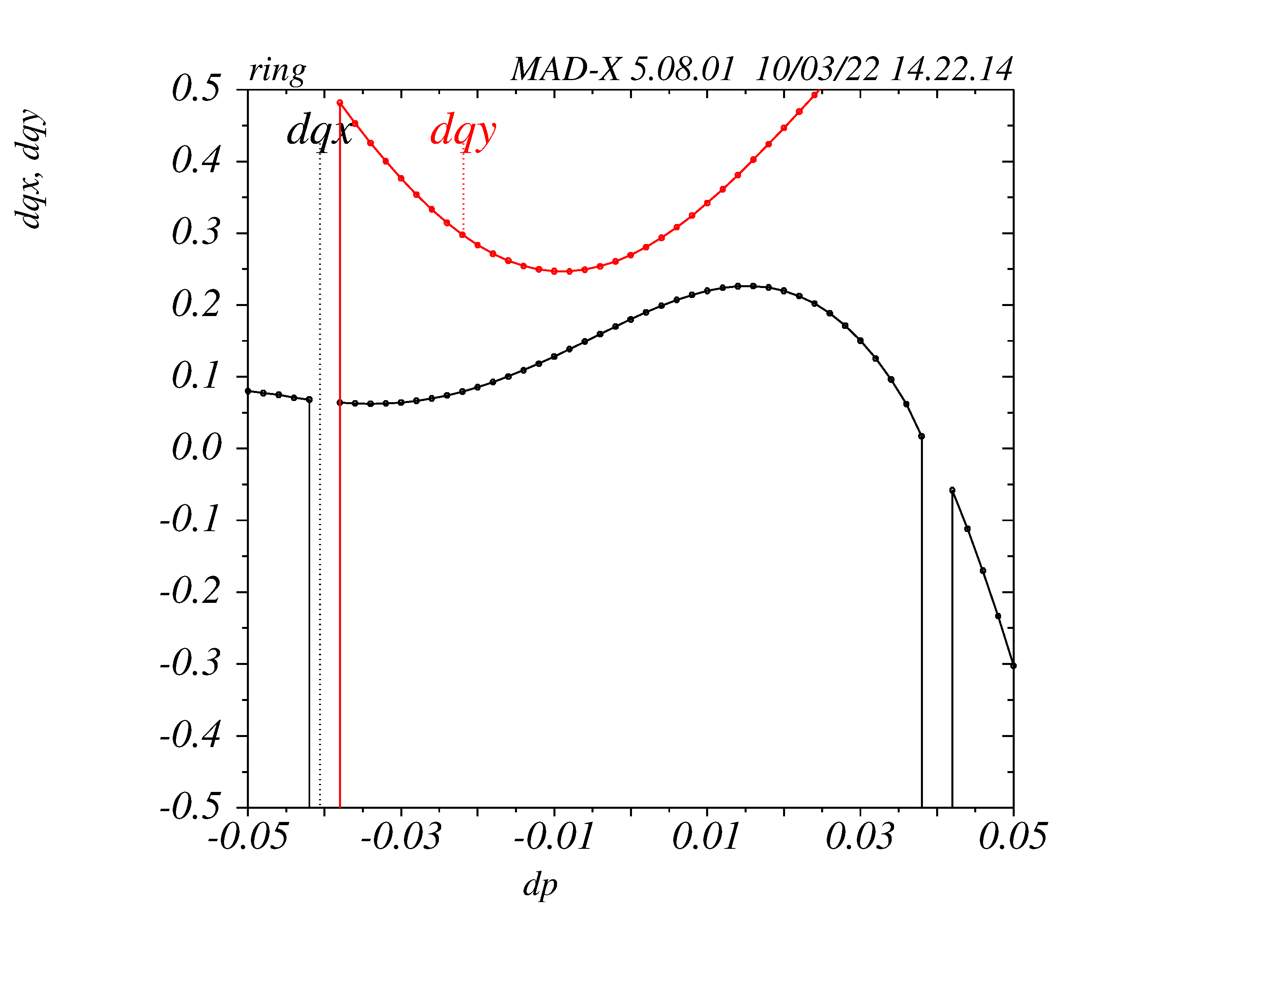
  Octupoles influence the tune vs dp/p
Octupole K3 = -30000 m⁻⁴
Octupole K3 = -27000 m⁻⁴
lower chromaticity of +5/+5
3.8%
-2.8%
3.5%
ξ = +6 / +6
ξ = +5 / +5
Integer resonance crossing limits the LMA and can be controlled with lower chromaticity and lower octupoles
However the on momentum DA is reduced - A trade-off needs to be find

Slide 16
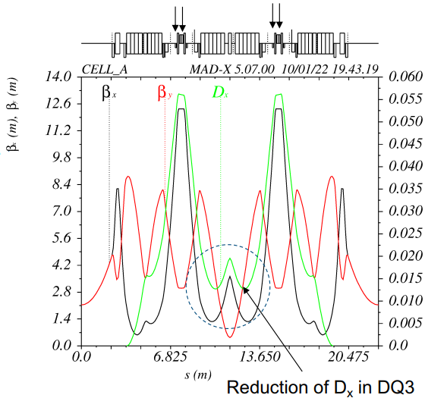
  Reverse bends impact was analysed
Quads used as reverse bends
Reverse bends were studied offsetting two pairs of
quadrupoles in the dispersion bump
moderate offset 0.7 mm was found to reduce the
cell emittance from 43 pm to 33 pm
No significant gain in DA and MA
However the RF power due to beam losses
is reduced by 25% (U₀ = 3.2 MeV/turn from 4.2 MeV/turn)
Power consumption is becoming an issue
This might trigger some modification to the baseline lattice

Slide 17
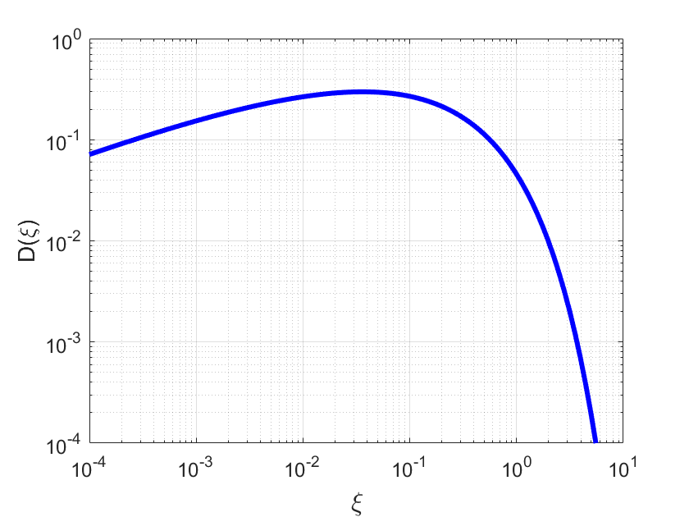
  Touschek lifetime and ultra-low emittance
Ultralow emittance ring explore a new regime for Touschek lifetime.
Touschek loss rate [Bruck (flat beam), Piwinski (coupled beam)]
3rd generation light sources operate in the region where D(ξ) is flat
(ε_{acc} = 3%; beta 10 m; 3 GeV; ε_{x} = 3 nm) ~ ξ ~ 0.09
New upgrades will probe the new Touschek regime
MAX-IV – like (ε_{acc} = 4%; beta 5 m; 3 GeV; ε_{x} = 0.3 nm) ξ ~ 0.77
PETRA IV – like (ε_{acc} = 3%; beta 5 m; 6 GeV; ε_{x} = 20 pm) ξ ~ 1.6
lower emittance → small transverse momentum σ_{x}’ → γσ_{x}’ < ε_{acc}
New Touschek
regime

Slide 18
  Emittance reduction with damping wigglers
For wiggler field not too large (negligible self-dispersions), damping wigglers
reduce the emittance
increase the radiation damping rate
limited energy spread increase
U₀ ~ I₂
τ_{x} ~ 1/I₂ ~ 1/U₀
PETRA IV H6BA lattice (no Damping Wigglers)
ε_{x} = 43.5 pm*rad
σ_{p} = 0.71e-3
U₀ = 1.25 MeV/Turn
PETRA IV H6BA lattice with Damping Wigglers
ε_{x} = 19.3 pm*rad
σ_{p} = 0.90e-3
U₀ = 4.17 MeV/Turn
energy spread increases but still limited
ε_{x} ~ 1/I₂ ~ 1/U₀
negligible self-dispersion
σ_{ε}² increases with U₀
e.g. approx. σ_{ε}² ~ U₀ª

Slide 19
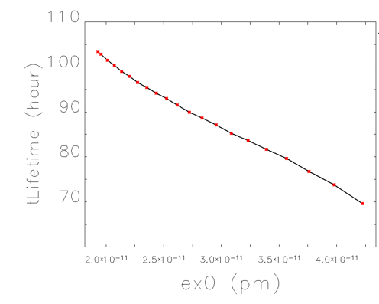
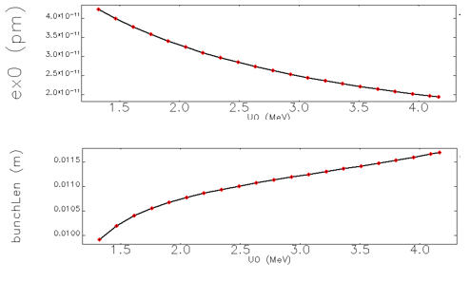
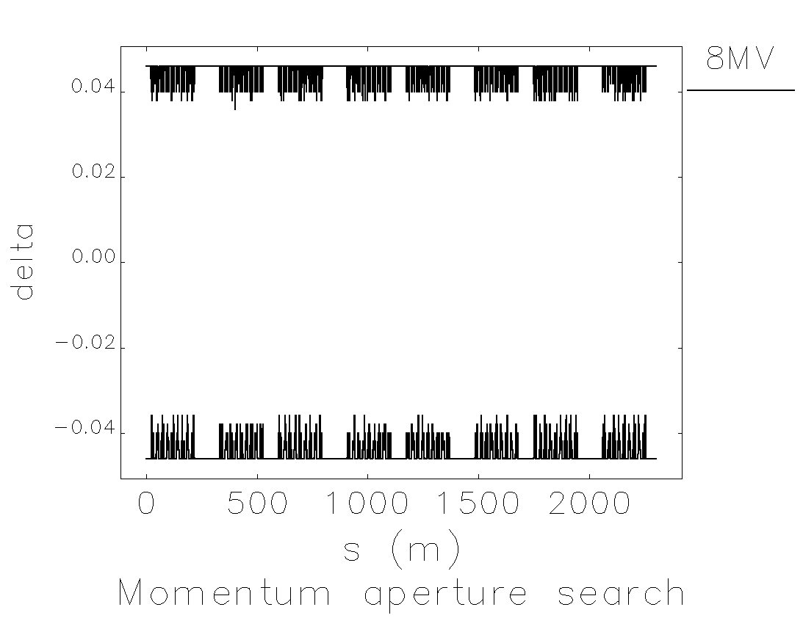
  The PETRA IV upgrade – the ring with the lowest ε_{x}/γ²
H6BA lattice, 6 GeV, 20 pm emittance with damping wigglers (43 pm no damping wiggler)
U₀ (MeV)
U₀ (MeV)
U₀ (MeV)
200 mA in 1600 bunches - 20 pm lattice
local momentum aperture ~4% (no errors) TLT ~100h
Reducing the emittance from 43pm to 20pm with damping wiggler
by increasing U₀ from 1.2 MeV/turn to 4.2 MeV/Turn
Increase in lifetime of ~52%
(small contribution from bunch lengthening)
However significant reduction of MA with errors reduce lifetime
Notes:
Bunch length? HC for optimal bunch lengthening

Slide 20
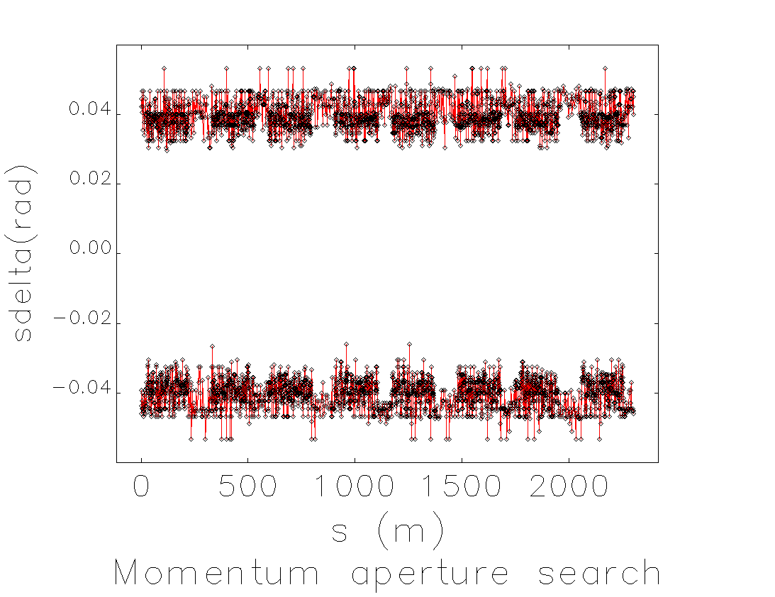
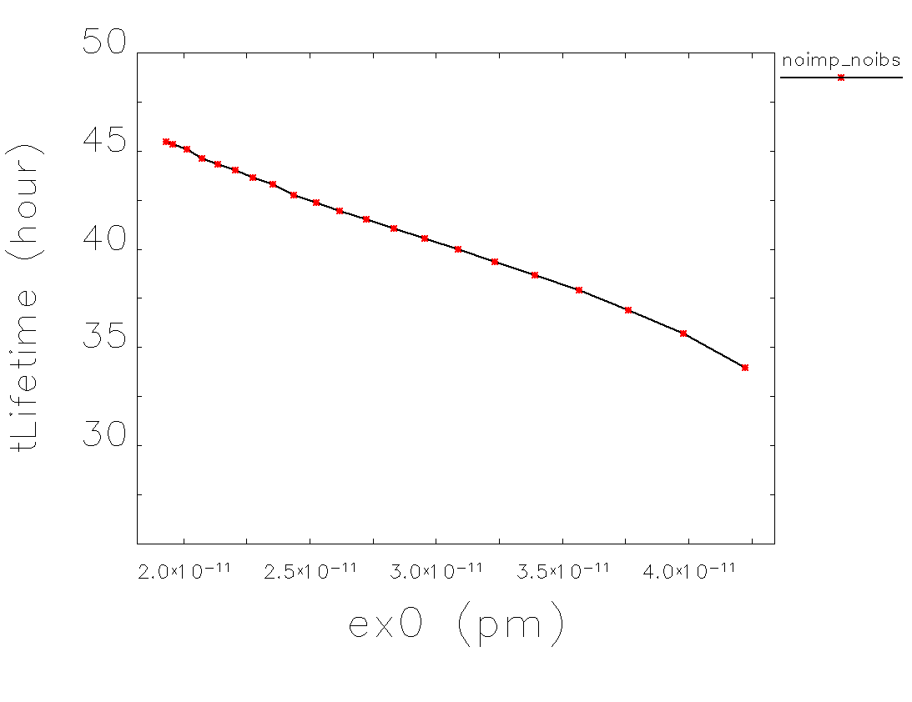
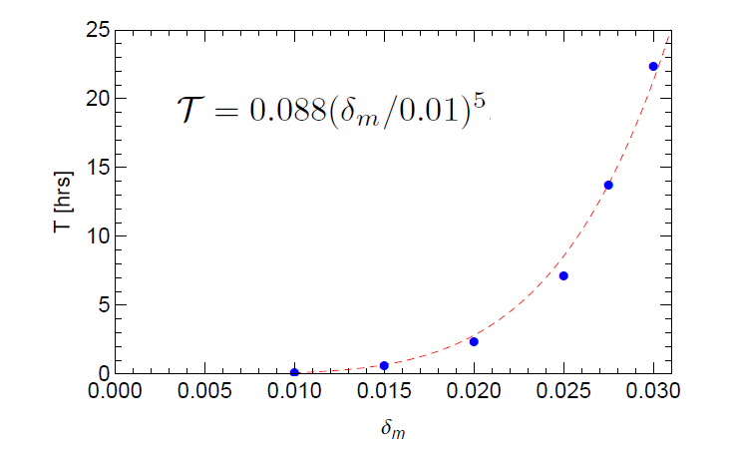
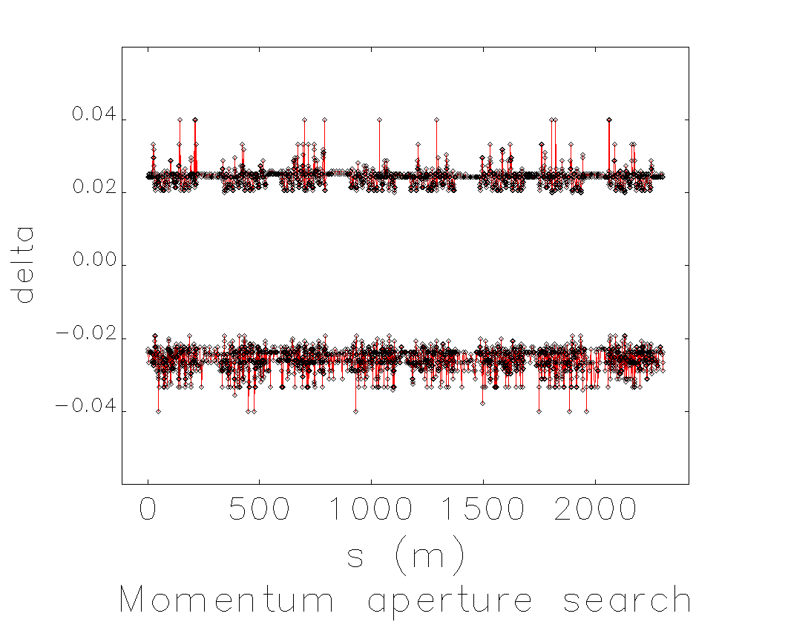
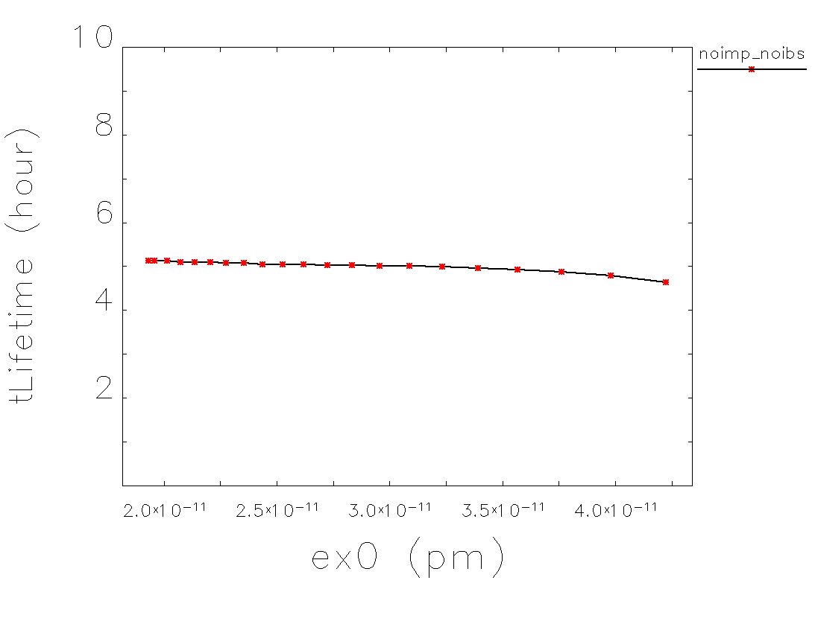
  Touschek lifetime sensitivity to momentum aperture
Lifetime increase with emittance is very sensitive to the momentum aperture
With errors seeds providing a residual ~5% beta beating or poor MA the Touschek lifetime is quickly reduced
ε_{acc} ~3.6 %
ε_{acc} ~2.1 %
Lifetime calculations as a function of momentum aperture predict a dependence more rapid than ε_{acc}³
Example from PEP-X (Cai, PRSTAB 2012)

Slide 21
  IBS with damping wigglers
Tx (IBS) also varies with the emittance (and with U₀) and in some conditions it scales approximately proportional to the emittance. From Bane formula
σ_{y} ~ constant fixed at e.g. 8 pm
σ_{H} ~ (ε_{x}/H_{x})^{1/2}
σ_{s}σ_{p} grows with U₀
approximation → σ_{s}σ_{p} ~ U₀ ^{(1/4)} ~ ε_{x} ^{(-1/4)}
In this regime T_{x}(IBS) ~ ε_{x} ~ 1/U₀
When the emittance is reduced with moderate field damping wigglers, the contribution to the equilibrium IBS emittance by IBS and radiation damping can compensate each other
τ_{x} radiation damping → τ_{x} ~ ε_{x} ~ 1/U₀
T_{x} IBS growth rate → T_{x}(IBS) ~ ε_{x} ~ 1/U₀

Slide 22
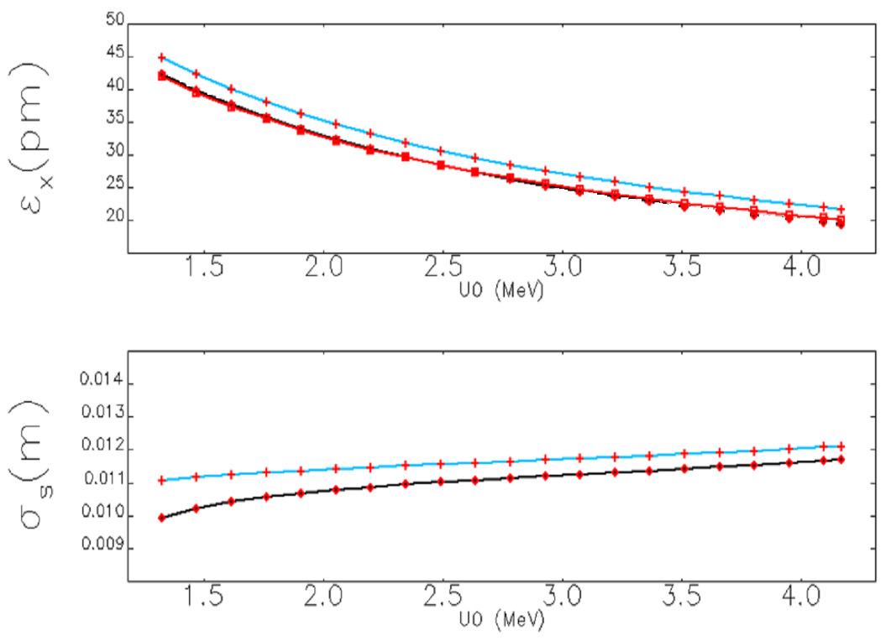
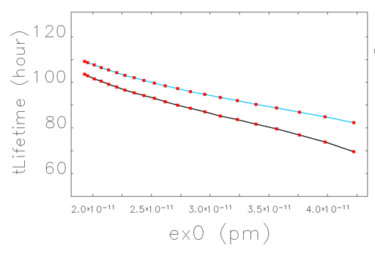
  Emittance and IBS with damping wigglers: PETRA IV
Calculation of IBS equilibrium emittance for PETRA IV as a function of the energy loss per turn produced by the damping wigglers
H6BA lattice, 6 GeV, 20 pm emittance with damping wigglers (43 pm no damping wiggler)
Brightness mode 200 mA in 1600 bunches (0.125 mA per bunch – 0.97 nC) (no errors)
IBS emittance increase
~constant for all emittances
and small
limited to 6% - 16%
(compared to 40% expected from the same emittance reduction without damping wigglers) via
IBS
no IBS
IBS
no IBS
IBS
no IBS

Slide 23
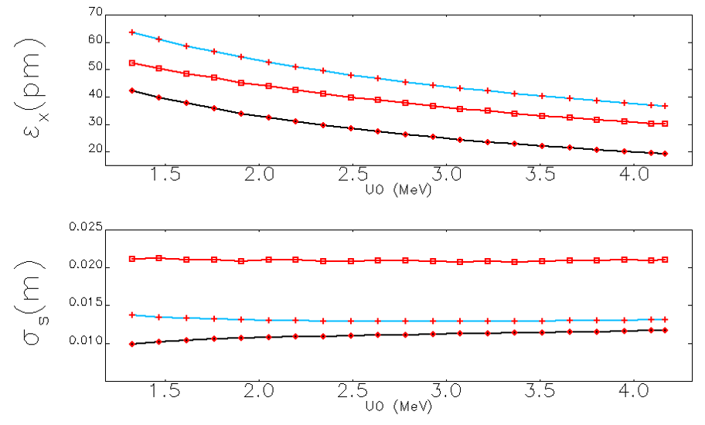
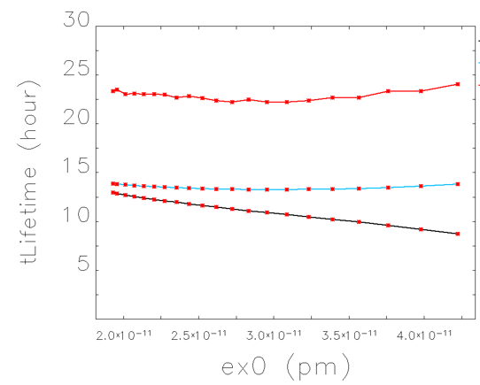
  Emittance and IBS with damping wigglers: PETRA IV
Calculation of IBS equilibrium emittance for PETRA IV as a function of the energy loss per turn produced by the damping wigglers
H6BA lattice, 6 GeV, 20 pm emittance with damping wigglers (43 pm no damping wiggler)
Timing mode 80 mA in 80 bunches (1.0 mA per bunch – 7.7 nC) (no errors)
The beam dynamic is dominated by collective effects
not by IBS
Strong bunch lengthening reduces the IBS emittance increase
The IBS emittance increase is
~constant for all emittances
Relative emittance increase
IBS + IMPEDANCE 20%-110%
no IBS; with IBS; with IBS + Impedance

Slide 24
  PETRA IV
  Magnets
Magnet summary and challenges:
some quadrupoles have significantly large gradients
programme based on PM extended to DLs and DLQ
collaborations with ESRF established and with Daresbury [open to further partners]
engineering integration ongoing

Slide 25
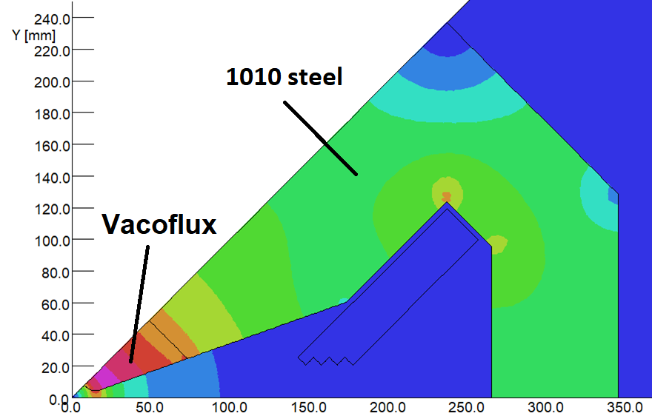
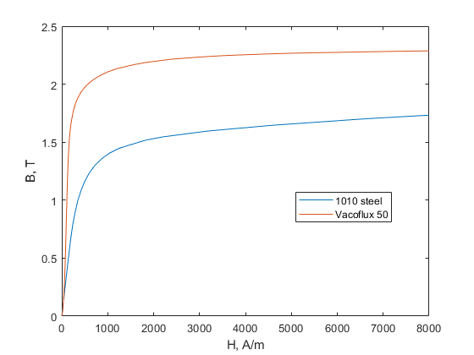
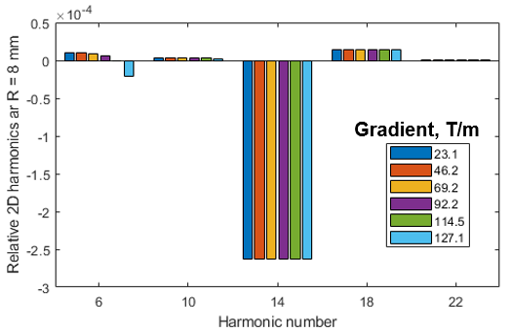
  Magnet design is progressing: high gradient quads
High gradient quadrupoles (PQA, PQB) in the triplet of the straight section require large gradient 115 T/m
smaller bore radius (11 mm)
vacoflux poles
Magnet designed meeting the specifications.
Documents for the call for tender for the prototype are ready

Slide 26
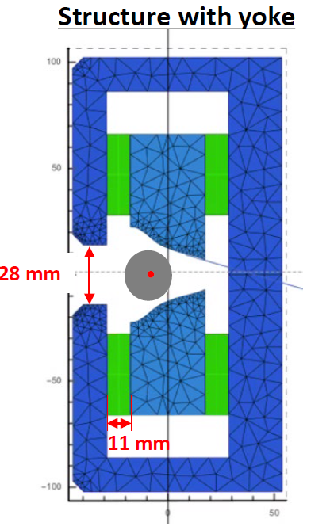
  Extensive use of permanent magnet based CF dipoles
Dipole magnets will be either longitudinal dipoles or combined longitudinal dipole with a transverse gradient
432 PM magnets in total
DLQ with different modules but same ratio B/G
i.e. same pole tip design
Design concentrating on the hardest DLQ module DL1A_3
R&D on PMQ (not in baseline)
Supported by the I-FAST project
Collaboration with ESRF

Slide 27
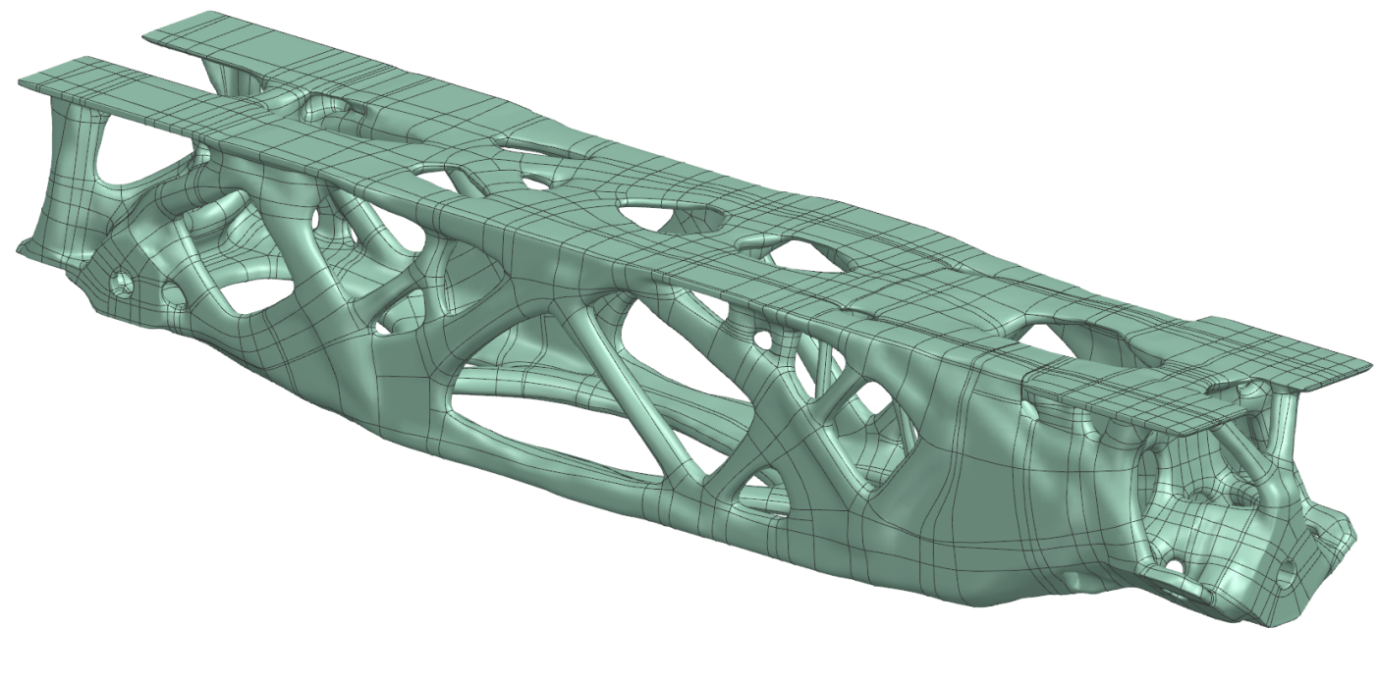
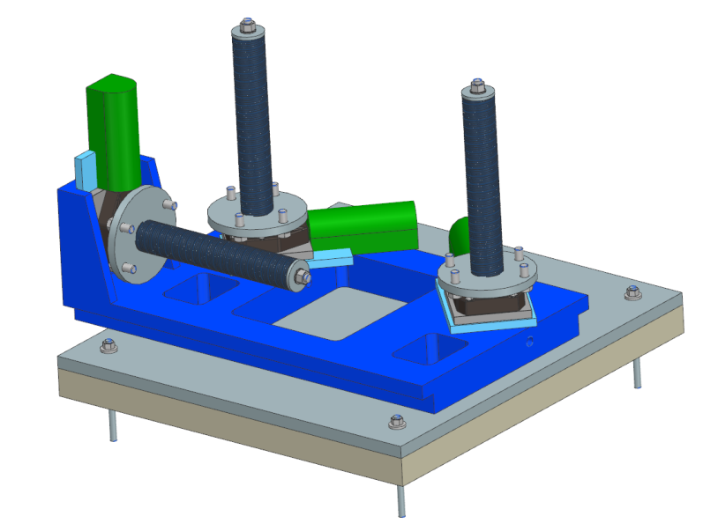
  Novel girder structures are proposed
Topology optimization of the Girder
Process established to generate a new design in 3 days
Design V6.2.1 includes the girder surface and reduced the
weight to < 4t
Girder to magnet connection
Magnet interface defined
Cad Model produced
Girder Mover
Initial design finished
Currently in contact with suppliers to order parts
Magnet Alignment Unit
Cooperation with AZETA to develop such a unit
high precision electric/hydraulic

Slide 28
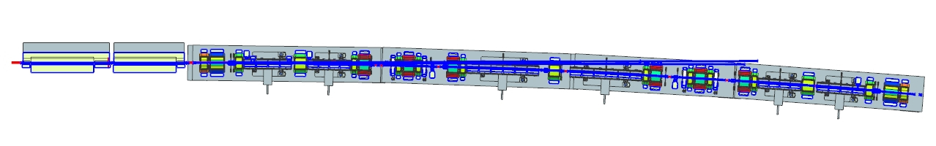
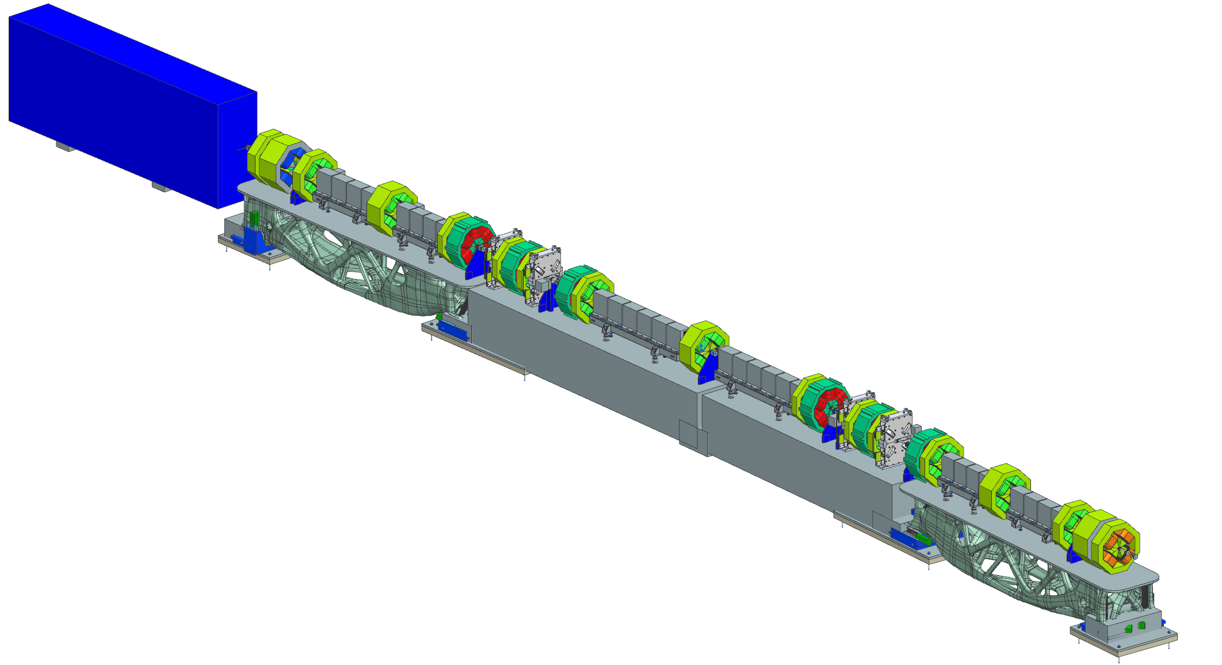
  Engineering integration ongoing
Preliminary design of the vacuum system available
Evaluation of canted extraction of the photon cone and possible clashes is ongoing
Engineering integration:
all magnets in the final design stage
engineering integration of all components in the cell on the girders
check on space envelope and clashes
design of the extraction photon pipe
Implementation of the canted photon beamlines

Slide 29
  Conclusions
Many projects will come on line in the next years and competition is fierce
MAX IV in operation (200 mA – IPAC17)
ESRF-EBS in operation in August 2020
Sirius (Brazil) in operation at November 2020
APS-U (US) under construction – operation in 2023
HEPS (China) construction phase started – operation in 2025
ELETTRA 2.0, SLS-II and SKIF recently funded
ALS-U, Diamond-II now moved to TDR phase with substantial R&D programmes. Many labs are investigating options (CLS, SOLEIL, PAL, BESSY, ...) in more or less advanced consultations with users in view of CDR/TDR
PETRA IV is the highest priority project at DESY and promise to deliver beams with world leading emittance and brightness
Lattice well defined. Many elements of the machine are close to their final design.
Prototypes are on the way
Recruitment is progressing

